Slide 1

Experience SereniTEA
A presentation by Nicholas Urrutia
This Photo by Unknown author is licensed under CC BY-NC.

Slide 2
Techstack
Visual Studio 2022
C#
.NET Core 5.0
Swagger
ASP.Net
ADO.Net
SQL Server
MSSQL
Serilog

Slide 3
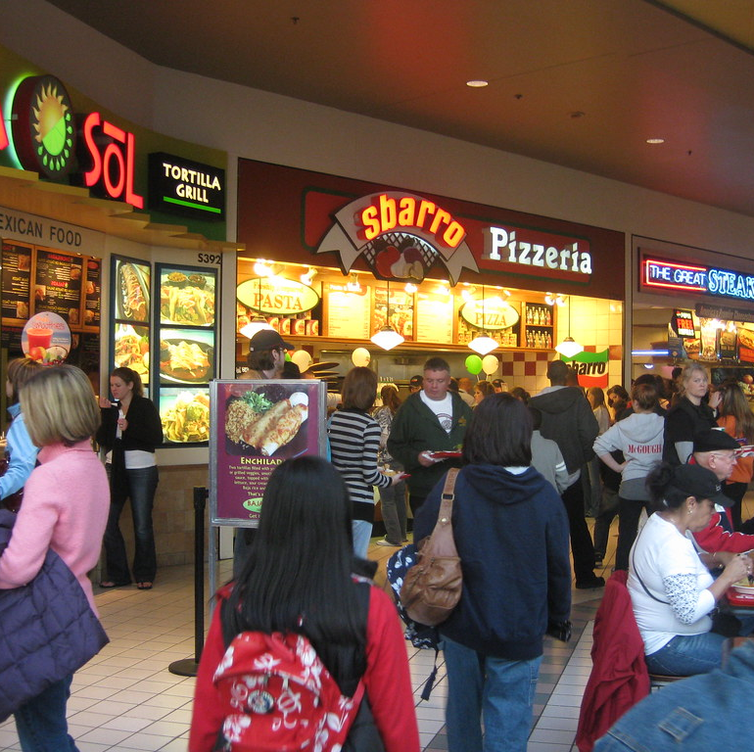
Has This Ever Happened to You?
Walking around a public place and suddenly you're thirsty?
You crave a satisfying beverage but the lines for the restaurants are huge?
And finally, when you get to the front of the line, you must wait even longer while they make your beverage?
No longer!
This Photo by Unknown author is licensed under CC BY.

Slide 4
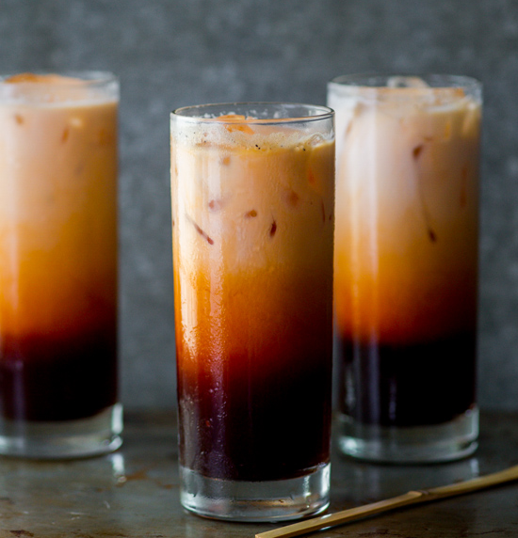
Introducing SereniTEA!
Order your beverages through our convenient and easy-to-use app!
Plenty of beverages to choose from!
Lines? Forget about 'em!
You will be notified via text or email 1 minute in advance when your order is ready to pick up to ensure the best beverage experience.
Limited Contact due to the online nature of our ordering system!
Enjoy all the extra time now available to you now that you don't have to wait in line! Simply order then pick up your drinks when they are ready!
This Photo by Unknown author is licensed under CC BY-SA.

Slide 5
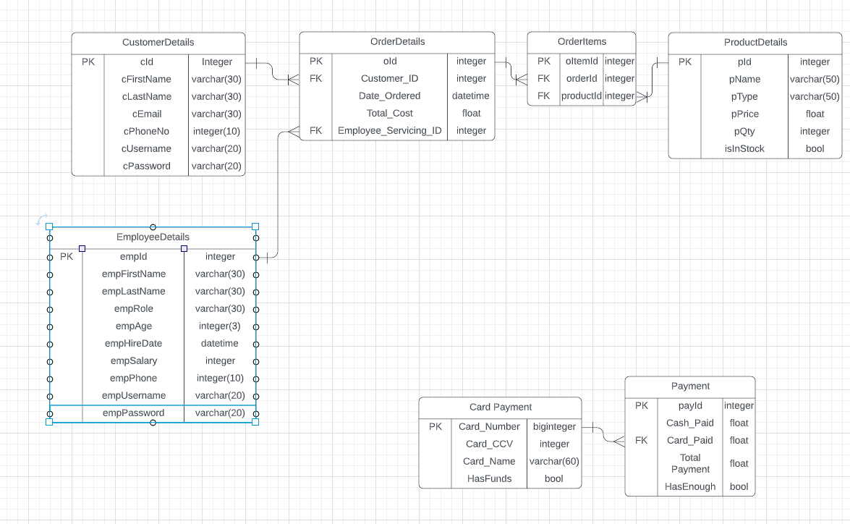
Implementable and Available for Further Updates!
Basic Framework is Basically Set!
Available for Expansion of Services!
With your generous contributions, we can add more products and services to our already impressive repertoire!

Slide 6
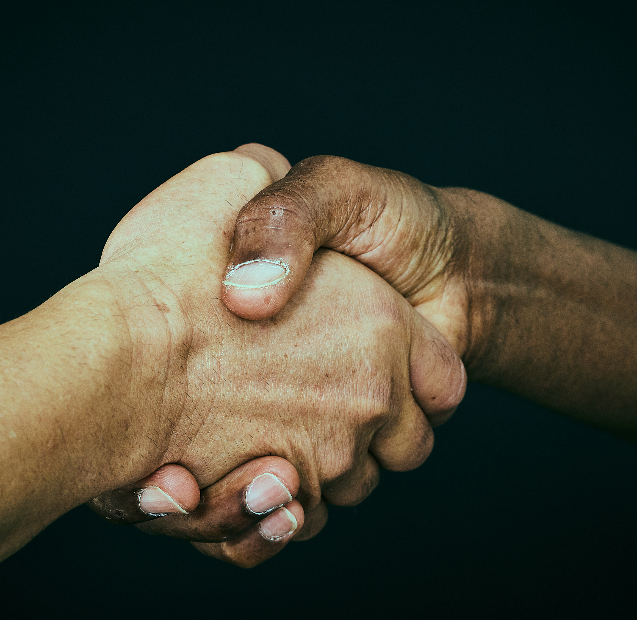
Thank you for your time and consideration!

